Slide 1
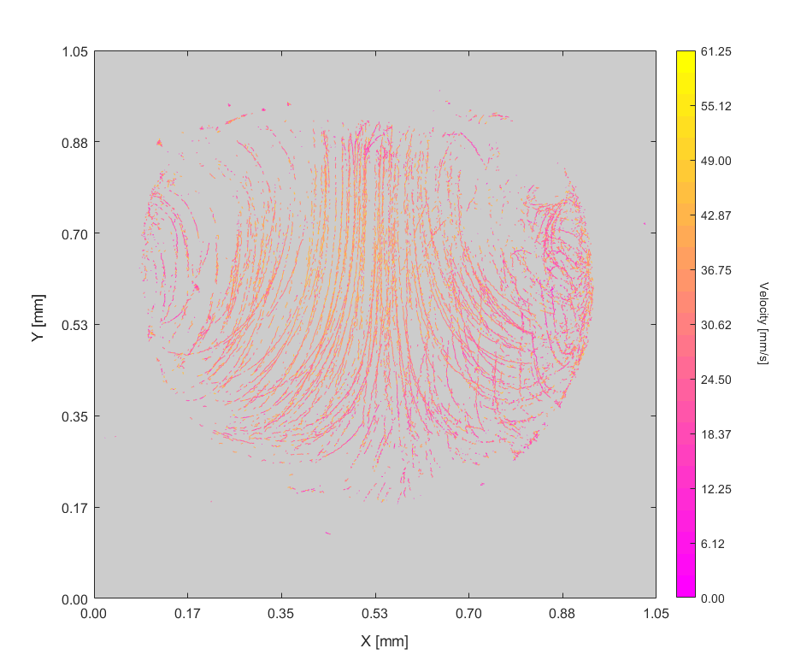
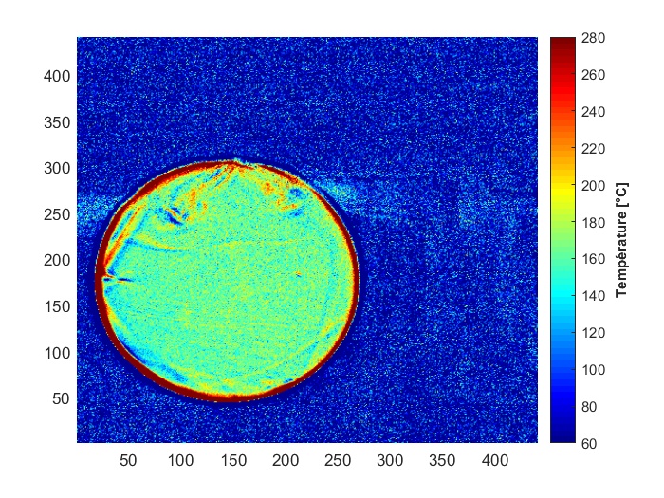


Mesure du champ de température dans une goutte d’émulsion d’eau dans l’huile par LIF-2c.
Authors:
T. Naudin(1,2), R.Calabria(1), D. Tarlet(2), P. Massoli(1), J. Bellettre(2)
(1) CNR - Istituto di Scienze e Tecnologie per l’Energia e la Mobilità Sostenibili – Naples, Italy
(2) Laboratoire de Thermique et Energie, CNRS UMR 6607 – Nantes Université, France
Journées annuelles du GDR CNRS TRANS-INTER, Aussois, 23-25 Septembre 2024

Slide 2
Introduction Materials & Methods Results Conclusion & Perspectives
Presentation Contents
  Introduction & context of the study
    Water-in-oil emulsions and its effect on combustion
    Aim of the study
  Material & methods
    2 colors Laser Induced Fluorescence technique for temperature field measurements
    Experimental bench presentation
  Results
Fluorescent dye initial characterization
Temperature dependency fluorescence Rf(T) calibration
Temperature measurements within droplets
Impact of fluid convective mixing on temperature field under radiant heating
  Discussion & perspectives

Slide 3
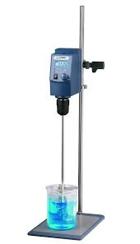
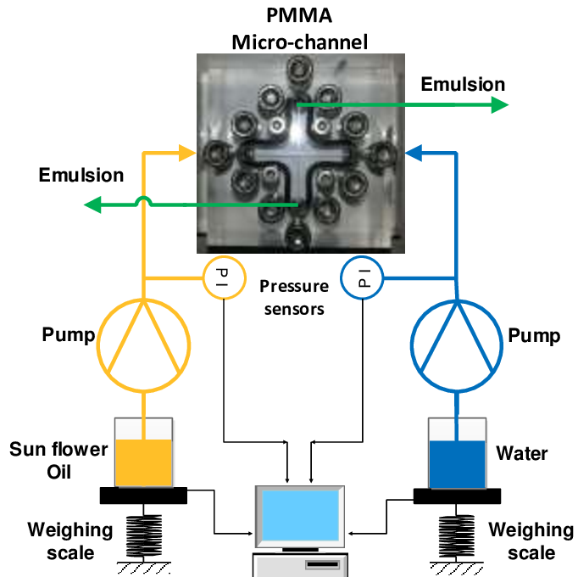

Introduction Materials & Methods Results Conclusion & Perspectives
Introduction – General context
Generalities on emulsions systems
An emulsion is a blend of 2 non-miscible liquids
A small quantity of water (dispersed phase) added to a continuous phase of combustible
Stirring action to obtain a dispersion of micro-droplets of water inside the continuous phase
Addition of a $3^{rd}$ component, surfactant to limit phase separation
Oil/combustible φ
Mechanical stirrer, ultrasonicator …
Water φ
Gain of energy by stirring
Micro-channel (LteN [1])
Polar (hydrophilic) head
Ji et al., Int. J. Multiphase Flow, 2020
Non-Polar (hydrophobic) tail

Slide 4
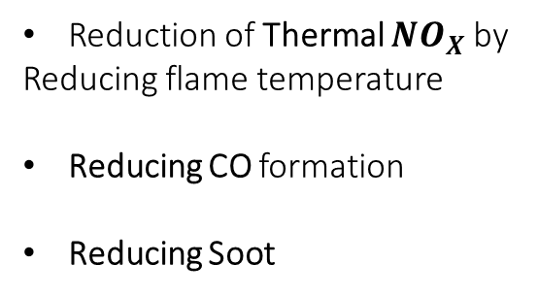
Introduction Materials & Methods Results Conclusion & Perspectives
General context
Benefits of adding water to a combustible
Reduction of Thermal ${NO}_{X}$ by
Reducing flame temperature
Reducing CO formation
Reducing Soot
Emulsification of liquid fuels by the addition of a small quantity of water :
Reducing pollutants emission by chemical reactions and lowering flame temperature due to water vaporization
Increasing combustion efficiency by a secondary atomization (micro-explosion) of a W/O droplet
See Abdollahi et al., Fuel 280, 2020 for example
The atomization of the mother drop results in a cloud of « daughter » droplets, enhancing the exchange surface

Slide 5
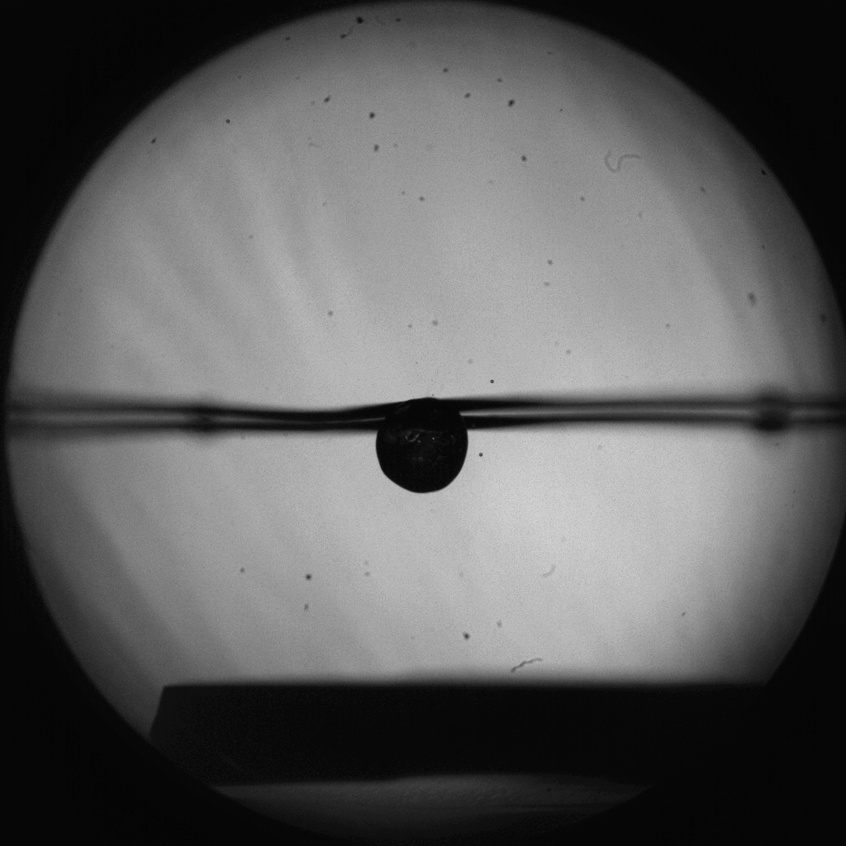

Introduction Materials & Methods Results Conclusion & Perspectives
What is a micro-explosion ?
The « Micro-explosion » event
Micro-explosion phenomenon : atomization of a « mother » emulsion drop in a cloud of finer droplets by a difference of boiling point between the two phases composing the emulsion
Continuous oily phase
Enhancing of combustible/air mixing and thus combustion efficiency
Vaporisation of the water droplets within the liquid oil drop
dispersed water phase [5-100] μm
Fragmentation, forming a cloud of « child » droplets

Slide 6
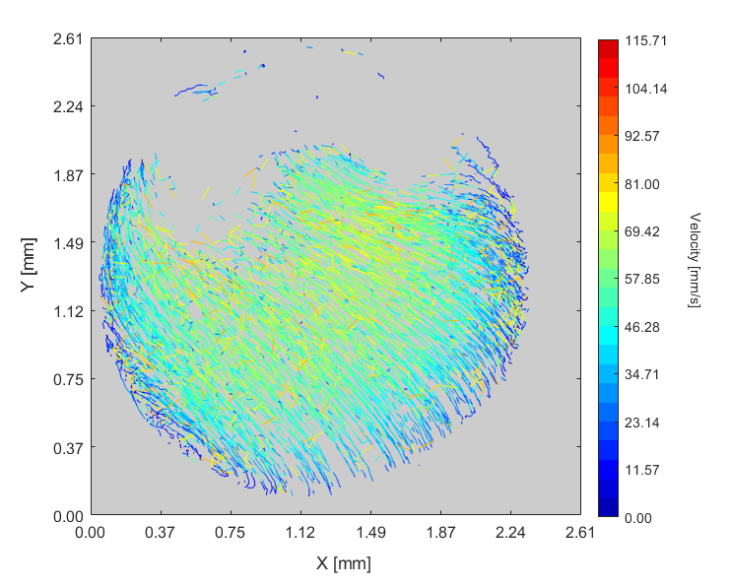
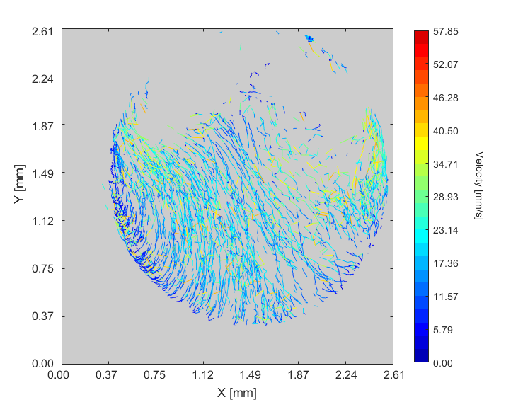
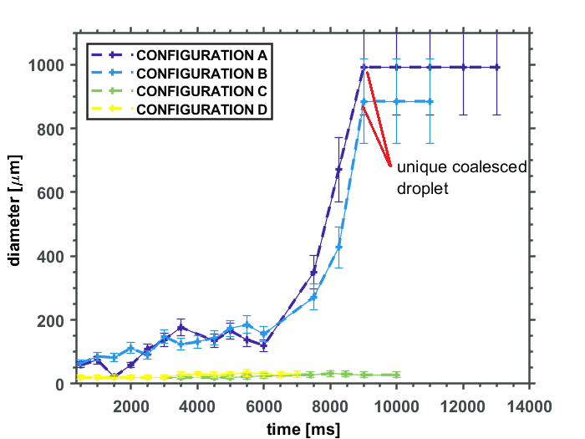
Introduction Materials & Methods Results Conclusion & Perspectives
Study of the behaviour of the dispersed phase and the impact of coalescence on ME
Results of previous Study
Previous study had interest on behavior of dispersed water micro-droplets by mean of LIF coupled to a PTV algorithm
It shown that for finely dispersed micro-droplets, a global motion of the droplets population exists
For coarse emulsions, the coalescence dominates and these motions are not observed
PTV results from previous study, (motions of the tracked water micro-droplets inside an emulsion drop)

Slide 7
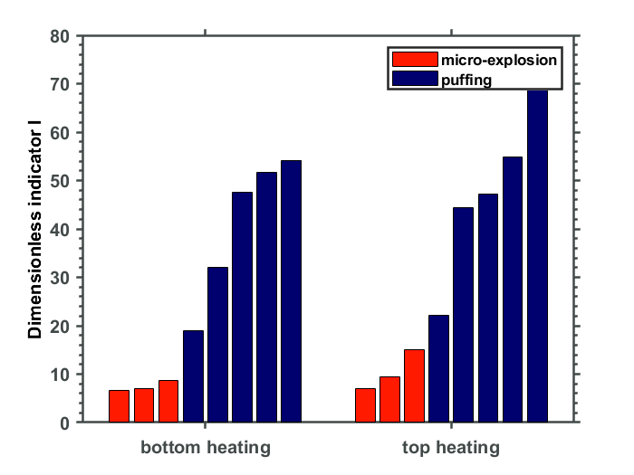
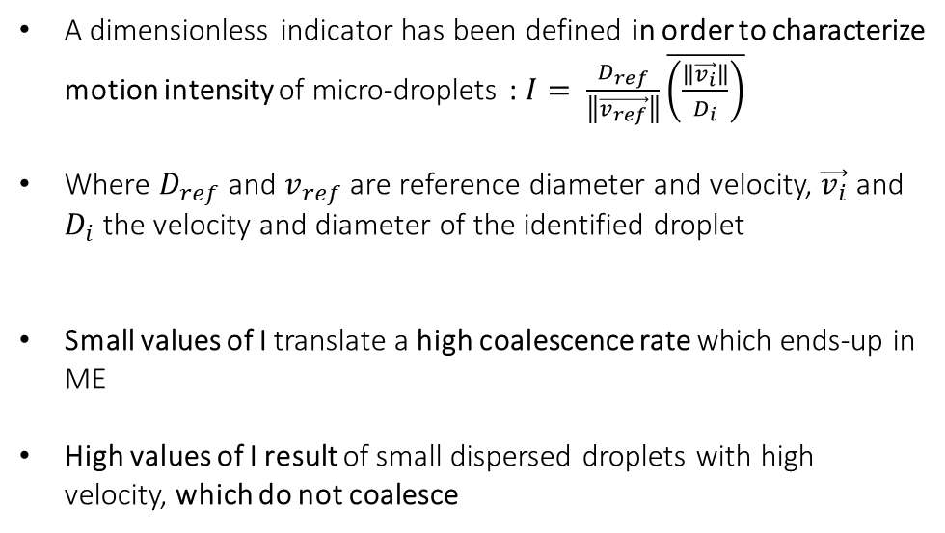
Introduction Materials & Methods Results Conclusion & Perspectives
Study of the behaviour of the dispersed phase and the impact of coalescence on ME
Results of previous Study
A dimensionless indicator has been defined in order to characterize motion intensity of micro-droplets : $I= \frac{D_{ref}}{\left\|\vec{v_{ref}}\right\|}\overline{\left(\frac{\left\|\vec{v_{i}}\right\|}{D_{i}}\right)}$
Where $D_{ref}$ and $v_{ref}$ are reference diameter and velocity, $\vec{v_{i}}$ and $D_{i}$ the velocity and diameter of the identified droplet
Small values of I translate a high coalescence rate which ends-up in ME
High values of I result of small dispersed droplets with high velocity, which do not coalesce
Link between internal circulation intensity and ME rate (quantified by number I)
Micro-droplets follow internal patterns :
A general motion, parallel streamlines that limits coalescence

Slide 8
Introduction Materials & Methods Results Conclusion & Perspectives
Study of the internal temperature field within an n-tetradecane droplet under radiant heating
Scope of the Study
Selected methods
To this aim, optical based on 2cLIF are implemented :
Allows one to obtain the full map of temperature ≠ single point measurement with a thermocouple
Non-intrusive (mainly)
Bases of the problematic
Principal objective : measurement of the 2D temperature field within a n-tetradecane droplet during the heating phase
Internal motion of the dispersed phase water has been observed
Buoyancy induced convection ?
If yes, there should be an internal gradient inside the droplet
Motion induced by internal convection ?
How the droplet is heated by IR heating ?

Slide 9
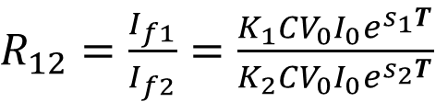

Experimental approach
Introduction Materials & Methods Results Conclusion & Perspectives
Study of the internal temperature field within an n-tetradecane droplet under radiant heating
Several ratiometric methods can be used
In our case, we focused on the 2 colours 1 single dye LIF (2cLIF)
Since the study concerns the continuous oily phase of the emulsion, a coherent dye had to be choosen
To combine non-intrusive method and obtain temperature field measurements, diagnostics based on LIF are used
$$I_{f}=K_{λ}CV_{0}I_{0}e^{s_{λ}T}$$
Fluorescence signal is among others dependent on temperature
Ratiometric methods (measurements on 2 different wavelengths simultaneoulsy) allow one to disregard parameters
$R_{12}=\frac{I_{f1}}{I_{f2}}=\frac{K_{1}CV_{0}I_{0}e^{s_{1}T}}{K_{2}CV_{0}I_{0}e^{s_{2}T}}$
Lemoine F. and Castanet G. (Experiments in Fluids, 2013)

Slide 10
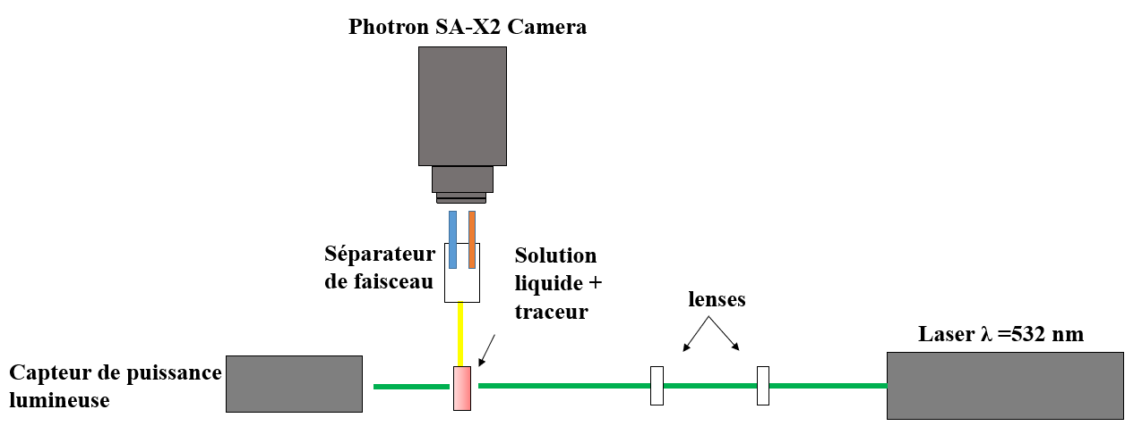
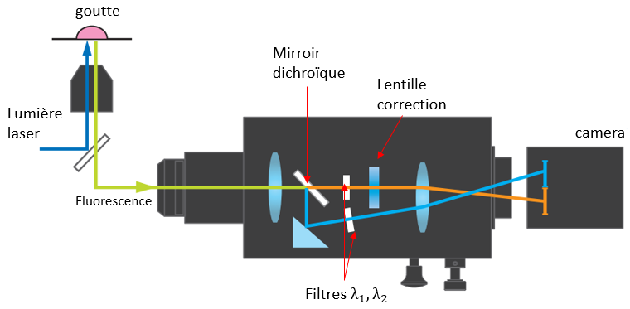
Introduction Materials & Methods Results Conclusion & Perspectives
Study of the internal temperature field within an n-tetradecane droplet under radiant heating
Experimental approach
Setup based on 2cLIF is employed
The fluorescence light is collected on two wavelengths simultaneously thanks to a « beam-splitter » (Hamamatsu Gemini V-wiew)
First step of the work consisted on characterization of a dye suitable for our experiment :
High solubility in the liquid of interst
Can be excited by the laser wavelength (532 nm)
Sufficient temperature sensitivity and emission in the visible spectrum

Slide 11
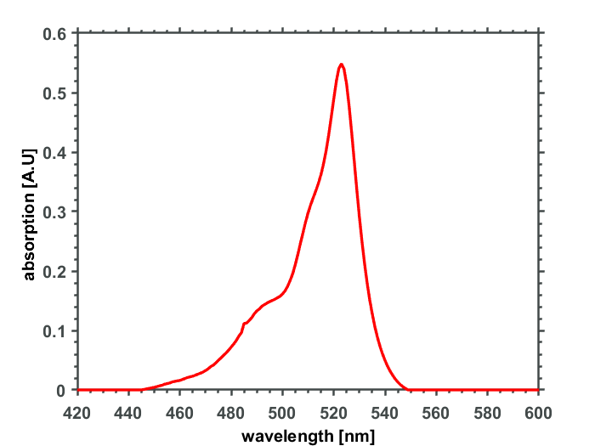
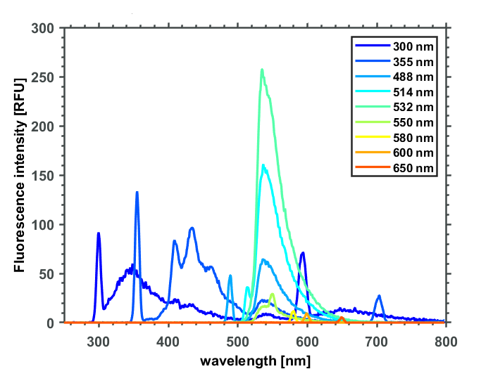
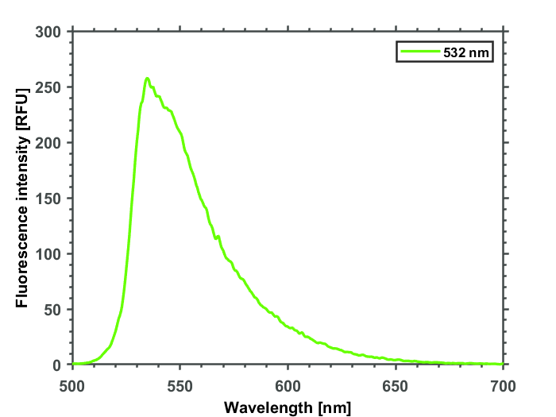

Introduction Materials & Methods Results Conclusion & Perspectives
Study of the internal temperature field within an n-tetradecane droplet under radiant heating
Dye caracterization
$$λ_{laser}=532 nm$$
Used dye : Pyrromethene 567, because of high solubility in the tetradecane
Step 1 : characterization of the absorption and fluorescence spectrums (performed in laboratory STEMS)
Absorption spectrum
Fluorescence spectrum
Plot of Fluorescence signal at only λ = 532 nm :
We observe that we have signal ranging from 510 to 650 nm ➔ Collection bands should be selected in accordance

Slide 12
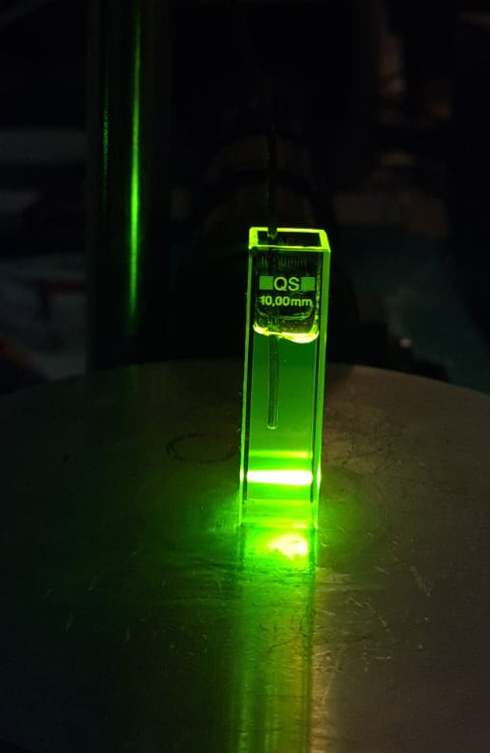
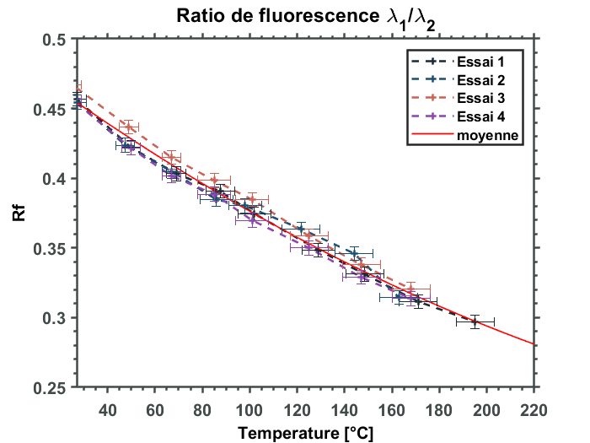


Introduction Materials & Methods Results Conclusion & Perspectives
Study of the internal temperature field within an n-tetradecane droplet under radiant heating
Calibration of the $R_{f}\left(T\right)$ function
A first calibration of $R_{f}\left(T\right)$ is realized inside a Quartz cuvette
The cuvette is heated by a thermostat-controlled hotplate
Bath temperature is doubled-check with a PT100 and a thermcouple K
Heated liquid bath
PT 100 + thermocouple
Fluorescence collection zone
Temperature uncertainty is estimated at +/- 7°C
𝑹_𝒇 (𝑻) function (average of 4 tests)
Exemple of fluorescence collection
λ₁ = 550 nm, λ₂ = 580 nm

Slide 13
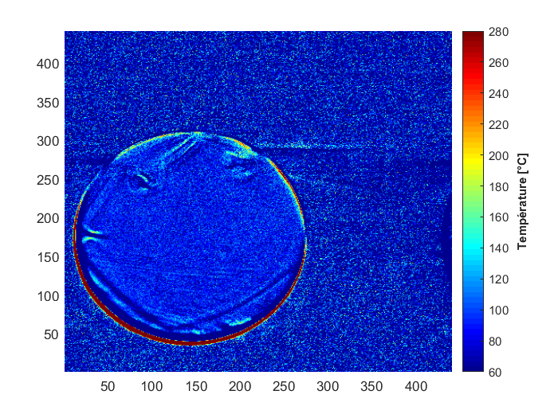
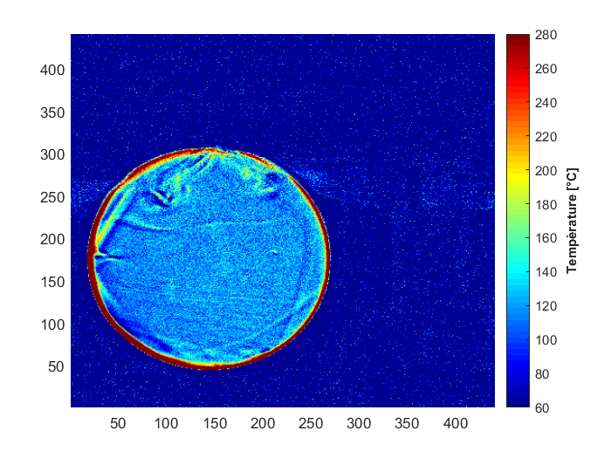
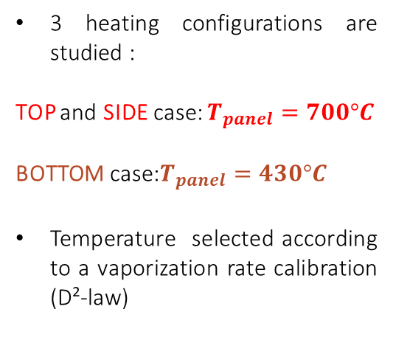



Introduction Materials & Methods Results Conclusion & Perspectives
Study of the internal temperature field within an n-tetradecane droplet under radiant heating
Results
Heating source Config. 3
$$Q_{radiative+}Q_{conductive}$$
3 heating configurations are studied :
TOP and SIDE case: $T_{panel}=700°C$
BOTTOM case:$T_{panel}=430°C$
Temperature selected according to a vaporization rate calibration (D²-law)
Heating source Config. 2
$$Q_{radiative}$$
In every heating configuration, the thermal field is quite homogeneous during heating
Thus, we suggest to investigate in details the 1D temperature profiles
$$Q_{convective+}Q_{radiative}$$
Heating source Config. 1

Slide 14
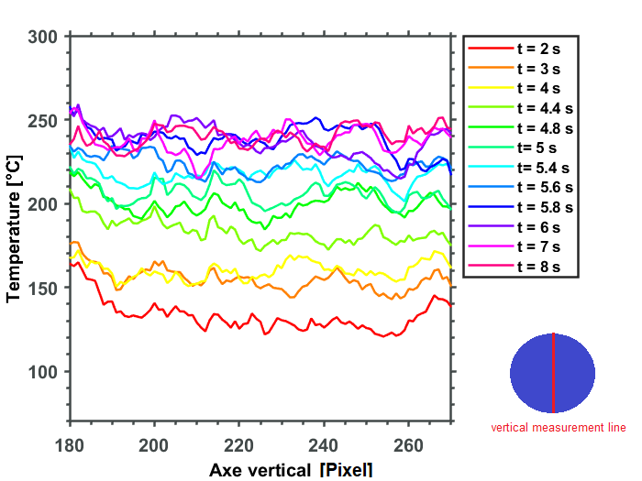
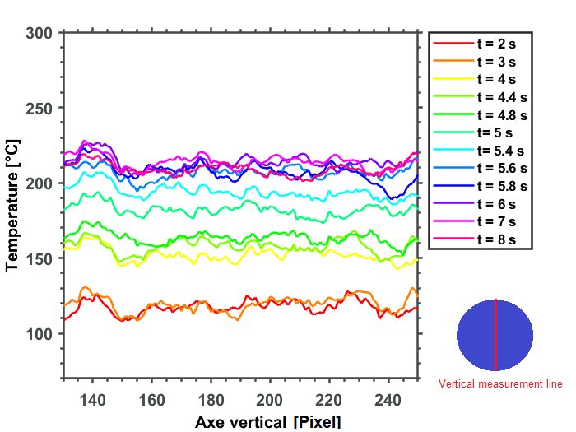
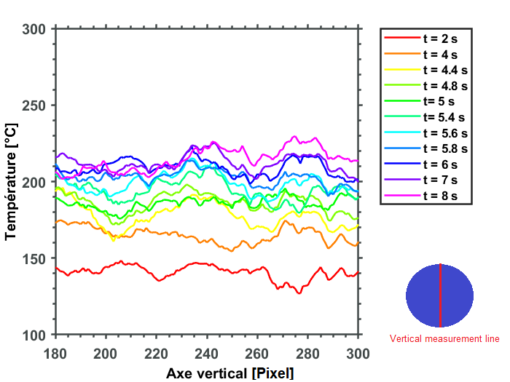
Introduction Materials & Methods Results Conclusion & Perspectives
Study of the internal temperature field within an n-tetradecane droplet under radiant heating
BOT CONFIGURATION
SIDE CONFIGURATION
Results - 1D temperature profile
1D temperature profiles along the vertical axis are computed
Profiles are analyzed during the heating period of the droplet
For each configuration, temperature profiles seems rather constant
The collection band ranges from the top to the bottom of the droplet, with a width of 3 pixels (30 μm)
TOP CONFIGURATION
In order to understand if the internal motion comes from buoyancy, vertical temperature gradient within the droplet is investigated

Slide 15
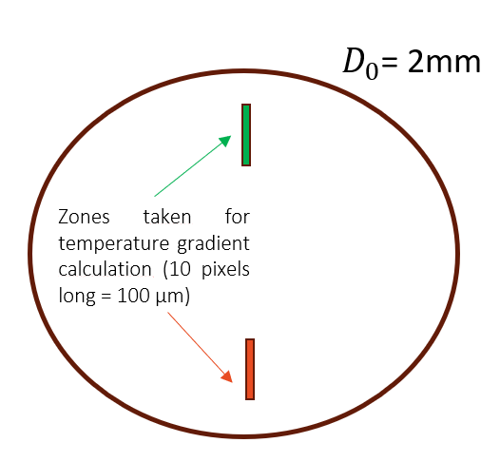
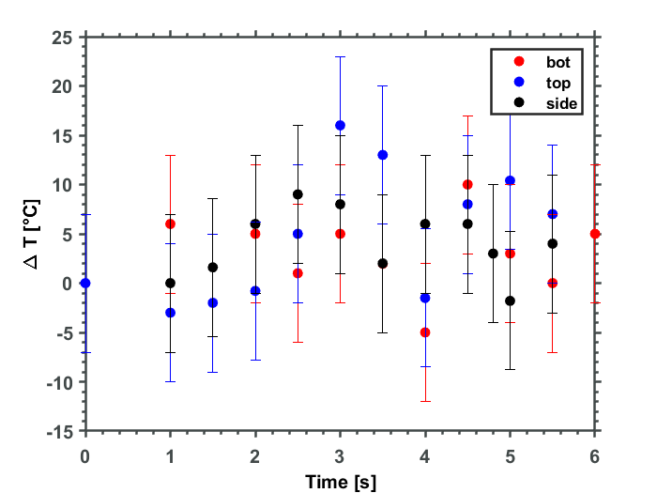
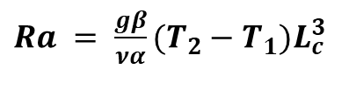
Introduction Materials & Methods Results Conclusion & Perspectives
Study of the internal temperature field within an n-tetradecane droplet under radiant heating
Results – internal ∆T
Calculation of internal Rayleigh Number
Rayleigh number is then calculated inside the droplet, using the following eq. :
To this aim, the temperatures are taken in two different zones of the droplet
$Ra = \frac{gβ}{να}(T_{2}−T_{1})L_{c}^{3}$
Illustration of the ∆T obtained in different cases

Slide 16
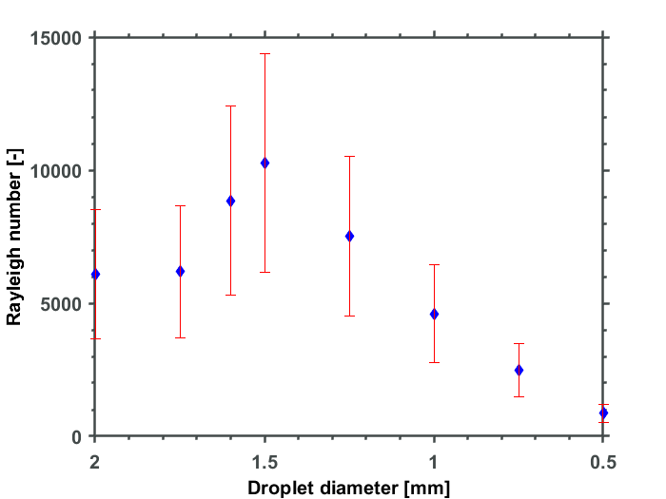



Introduction Materials & Methods Results Conclusion & Perspectives
Study of the internal temperature field within an n-tetradecane droplet under radiant heating
Results – internal Rayleigh
Number
Rayleigh number during heating and evaporation
Impact of the uncertainty of T measurements is reported
Rayleigh number is then calculated inside the droplet, using the following eq. :
Variations of the physical properties (g, β, α, ν) are considered
$Ra = \frac{gβ}{να}(T_{2}−T_{1})L_{c}^{3}$
Critical Rayleigh value for the onset of buoyancy is ${Ra}_{c}$ = 1700
${Ra}_{c}$ = 1700
During all the heating phase, $Ra$ > ${Ra}_{c}$
Therefore, there is a contribution of the thermo-gravitational convection (buoyancy) on the internal mixing of the liquid

Slide 17
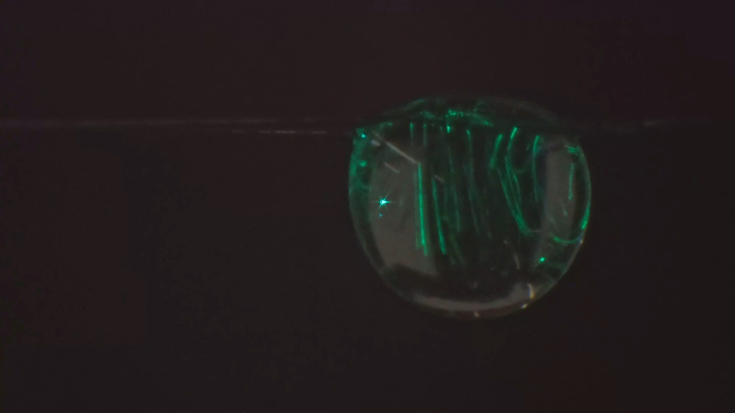
Introduction Materials & Methods Results Conclusion & Perspectives
Link to liquid internal mixing
Results – Internal motion
Accordingly to previous study (on water dispersed droplets), internal motion has been observed
Then, calculation of internal Rayleigh number allowed us to quantify the contribution of buoyancy on the mixing
Here, we suggest to have a glance to this mixing patterns
Example of internal flow within the droplet when heated by the top

Slide 18
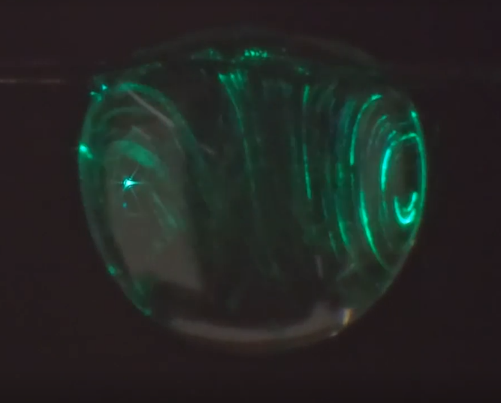
Introduction Materials & Methods Results Conclusion & Perspectives
Presentation Contents
Illustration of the internal mixing of the droplet
Raw images and Post-treated results from High speed Camera at 5000 FPS
Two quasi symmetrical vertical vortexes are observed both by the raw images and the PTV tracking
This flow pattern is known as Hill’s Vortices (Tam et al., J.Fluid.Mech 624, 2009) and is a first indicator of a contribution of Surface Tension Forces (Marangoni) on the flow

Slide 19
Conclusion
Introduction Materials & Methods Results Conclusion & Perspectives
Conclusion
2cLIF method has been sucessfully implemented in order to obtain 2D temperature field inside heated n-tetradecane droplets
3 configurations highlighting successively one type of heat transfert (convective or radiative) respect to others have been studied
In every case, temperature field seems rather homogeneous during the heating of the droplet. Plots of 1D temperature profiles also confirm this trend.
Internal Rayleigh number is calculated, depicting a contribution of the buoyancy in the liquid mixing
Next step of the work will aim to characterize the contribution of the surface tension with respect to buoyancy on the internal motion

Slide 20

Introduction Materials & Methods Results Conclusion & Perspectives
Conclusion
THANK YOU FOR YOUR ATTENTION

